Slide 1
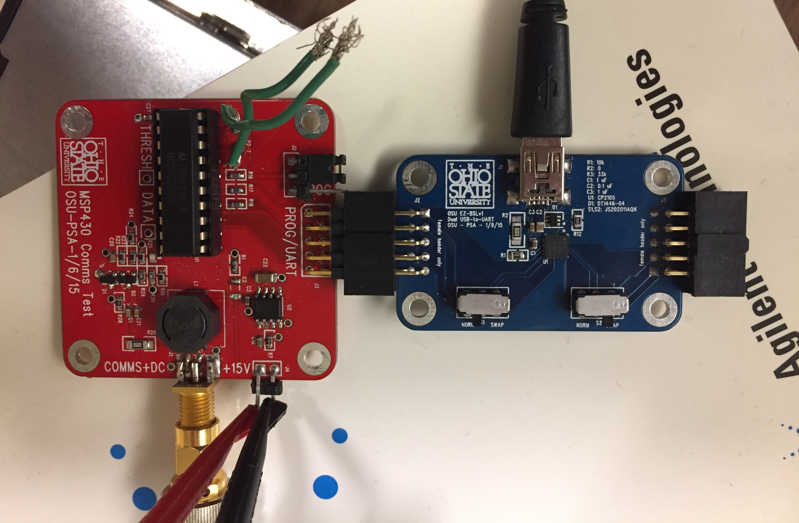
USB from Computer
USB Mini/J1
MSP430 Comms Tester
USB-to-UART Converter
SMA
J4
Power out to Quad
+15V /GND input
from DC power source

